Slide 1

Python Introduction

Slide 2
Camera Expectations

Slide 3


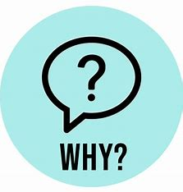
Before we start… Please have your camera switched on.
Camera Expectations
This is a mandatory requirement for the duration of the course.
You are studying a regulated qualification, your tutor needs to see that it is the right person participating throughout the course.
Our job is to prepare you for work in an age where in almost any job there is likely to be at least some aspect of remote engagement with your employer.
Online learning is to be treated the same way as a classroom learning, you must be physically visible to interact with your tutor and other learners in order to create an engaging group dynamic.

Slide 4
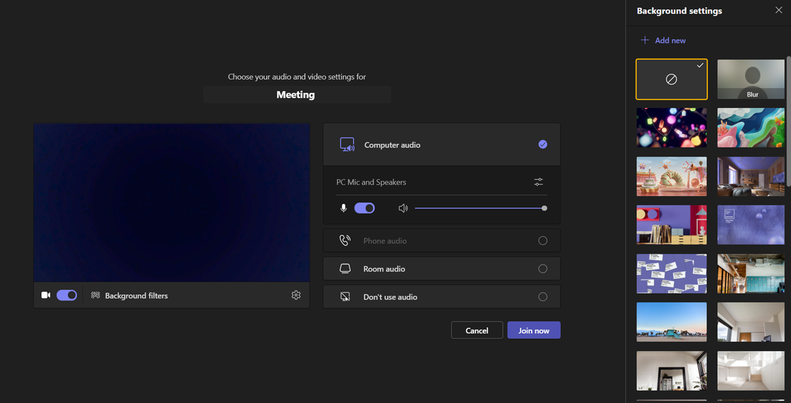
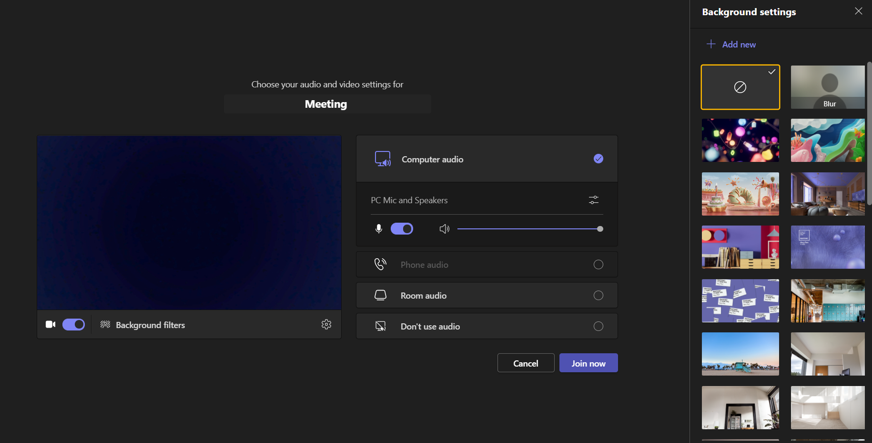
Background filters
If you do not wish to have your camera displaying your personal environment, Microsoft Teams has a solution to this problem…
Step One: Before you join a Teams video call, click the ‘Background Filters’ option.
Step Two: On the right-hand side, you can select any of the stock images.
Step Three: The image you choose will then appear in your background on the video call.
If you need any further support in regards to this requirement, please speak to your tutor directly.

Slide 5
Objectives
Comparison operators
IF Statements
Loops
Collection Data Types in Python

Slide 6
User Input
username = input("Enter username: ") print("Username is: " + username)
print(type(username))
Whatever you enter as input, input function convert it into a string. You need to explicitly convert it into an integer in your code.
num1 = int(input())

Slide 7
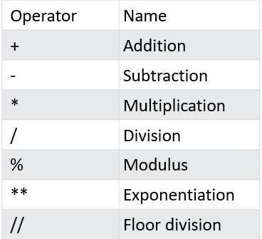
Arithmetic Operators
Arithmetic operators are used with numeric values to perform common mathematical operations:

Slide 8
Shortcut operators
It's time for the next set of operators that make a developer's life easier. Very often, we want to use one and the same variable both to the right and left sides of the = operator.
For example, if we need to calculate a series of successive values of powers of 2, we may use a piece like this:
x = x * 2 x *= 2
sheep = sheep + 1 sheep += 1

Slide 9
Shortcut operators
Expression | Shortcut Operator
i = I +2 | i += 2
var = var / 2 | var /= 2
rem = rem % 10 | rem % = 10
j = j – (i + var + rem) | j -= (i + var + rem)
x = x ** 2 | x **=2

Slide 10
Comparison: equality operator
Question: are two values equal?
To ask this question, you use the == (equal equal) operator.
Don't forget this important distinction:
= is an assignment operator, e.g., a = b assigns a with the value of b;
== is the question being these values equal? so a == b compares a and b.
It is a binary operator with left-sided binding. It needs two arguments and checks if they are equal.

Slide 11
Comparison: equality operator
print(2 == 2)
print(1 == 2)
var = 0 # Assigning 0 to var
print(var == 0)
var = 1 # Assigning 1 to var
print(var == 0)

Slide 12
Inequality
The != (not equal to) operator compares the values of two operands, too. Here is the difference: if they are equal, the result of the comparison is False. If they are not equal, the result of the comparison is True.
var = 0 # Assigning 0 to var
print(var != 0)
var = 1 # Assigning 1 to var
print(var != 0)

Slide 13
Comparison
print(centigrade_outside >= 0.0) # Greater than or equal to
print(current_velocity_mph < 85) # Less than
print(current_velocity_mph <= 85) # Less than or equal to

Slide 14
Conditional Statements

Slide 15
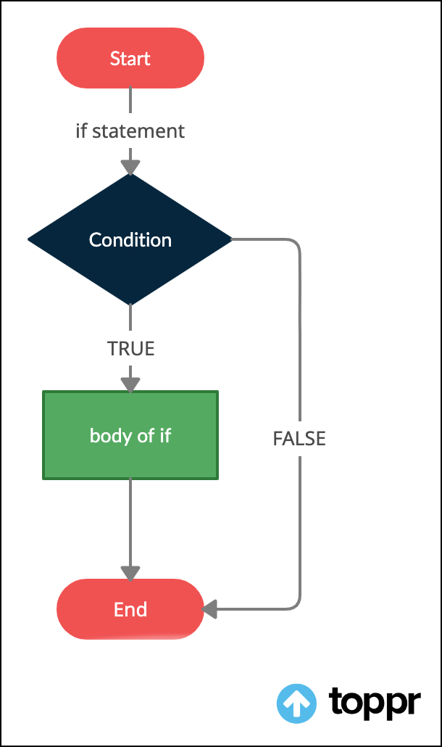
If Statement
You already know how to ask Python questions, but you still don't know how to make reasonable use of the answers. You have to have a mechanism which will allow you to do something if a condition is met, and not do it if it isn't.
It's just like in real life: you do certain things or you don't when a specific condition is met or not, e.g., you go for a walk if the weather is good, or stay home if it's wet and cold.
Notes:
https://www.toppr.com/guides/python-guide/tutorials/python-flow-control/if-elif-else/python-if-if-else-if-elif-else-and-nested-if-statement/

Slide 16
If Statement
If statement:
a = 33 b = 200 if b > a: print("b is greater than a")
Elif b< a:
print("b is less than a")
else:
print("b is equal to a")

Slide 17
If Statement
# Read two numbers
number1 = int(input("Enter the first number: "))
number2 = int(input("Enter the second number: "))
# Choose the larger number
if number1 > number2:
larger_number = number1
else:
larger_number = number2
# Print the result
print("The larger number is:", larger_number)

Slide 18
If Statement
The elif keyword is pythons way of saying "if the previous conditions were not true, then try this condition".
The else keyword catches anything which isn't caught by the preceding conditions.

Slide 19
While Loop
A while loop statement in Python programming language repeatedly executes a target statement as long as a given condition is true.
Example: print a number as long as it is less than 6:
i = 1 while i < 6: print(i) i += 1

Slide 20
While Loop
With the break statement we can stop the loop even if the while condition is true
With the continue statement we can stop the current iteration, and continue with the next
i = 1 while i < 6: print(i) if i == 3: break i += 1

Slide 21
While Loop Logic
False
While statement
Terminate the loop
Condition
True
Execute the block of code
Check the condition again

Slide 22
While Loop Exercise
Create a while loop that counts from 0 to 10 and prints odd numbers to the screen. Use the skeleton below:
x = 1
while x < 11:
# Line of code.
# Line of code.
# Line of code.
Notes:
x = 1 while x < 11: if x % 2 != 0: print(x) x += 1

Slide 23
For Loop
A for loop is used for iterating over a sequence (that is either a list, a tuple, a dictionary, a set, or a string).
fruits = ["apple", "banana", “berry"] for x in fruits: print(x)

Slide 24
For Loop
Loop through the letters in the word "banana":
for fruit in "banana": print(x)

Slide 25
For Loop
To loop through a set of code a specified number of times, we can use the range() function.
Parameter | Description
start | Optional. An integer number specifying at which position to start. Default is 0
stop | Required. An integer number specifying at which position to stop (not included).
step | Optional. An integer number specifying the incrementation. Default is 1
The range() function returns a sequence of numbers, starting from 0 by default, and increments by 1 (by default), and ends at a specified number.
range(start, stop, step)

Slide 26
For Loop Exercise
Write a Python program to print numbers from 1 to 50.
print('Numbers from 1 to 100:’)
for n in range(1, 51):
print(n, end=' ‘)

Slide 27
For Loop
Write a code to print all even numbers from 0 to 100.
my_number = 0
while my_number<=100:
print(my_number)
my_number +=2

Slide 28
Recap
What is the difference between while and for loop?
What is the output of the following code?
for i in range(0, 16, 3):
print(i)

Slide 29
Collection Types in Python

Slide 30
Collection Types in Python
It may happen that you have to read, store, process, and finally, print dozens, maybe hundreds, perhaps even thousands of numbers. What then? Do you need to create a separate variable for each value? Will you have to spend long hours writing statements like the one below?
var1 = int(input())
var2 = int(input())
var3 = int(input())
var4 = int(input())
var5 = int(input())
var6 = int(input())

Slide 31
List
Lists are used to store multiple items in a single variable.
Lists are one of 4 built-in data types in Python used to store collections of data, the other 3 are Tuple, Set, and Dictionary
Items in a list need not be of the same type.
Lists are created using square brackets:

Slide 32
Creating Lists
mylist = ["apple", "banana", "cherry"]
word = “happy”
mylist2 = list(word)
age = 32
mylist3 = list(age)
print(mylist)
print(mylist2)
print(mylist3)

Slide 33
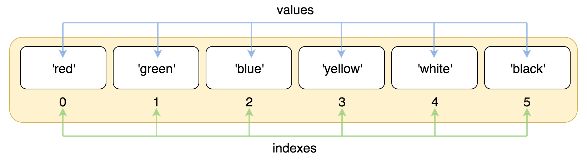
Accessing Values in Lists
colours = ['red', 'green', 'blue', 'yellow', 'white', 'black’]
print(colours[1]) >>> green
print(colours[4]) >>> ???
Notes:
https://railsware.com/blog/indexing-and-slicing-for-lists-tuples-strings-sequential-types/

Slide 34
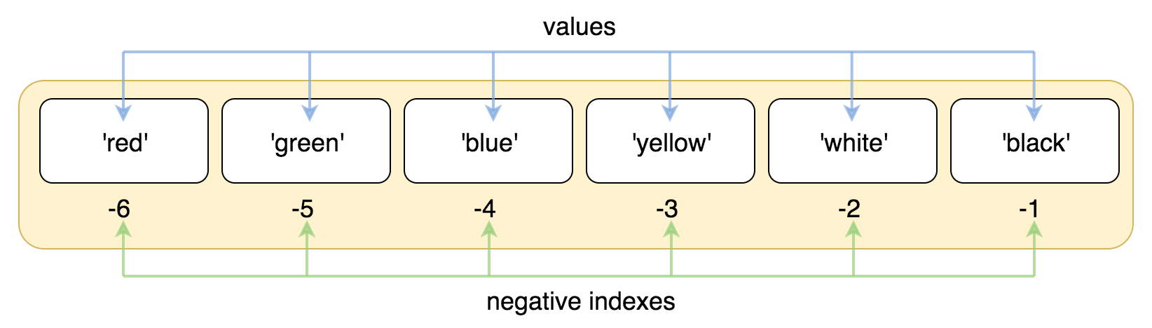
Accessing Values in Lists
colours = ['red', 'green', 'blue', 'yellow', 'white', 'black’]
print(colours[-2]) >>> white
print(colours[-5]) >>> ???
Notes:
https://railsware.com/blog/indexing-and-slicing-for-lists-tuples-strings-sequential-types/

Slide 35
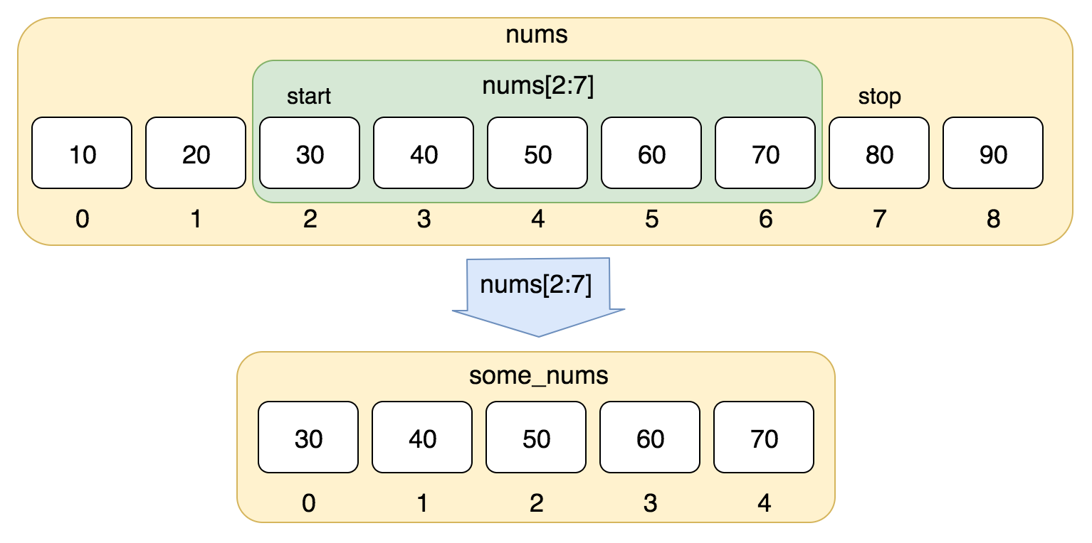
Accessing Values in Lists
print(nums[1:4])
30 40
print(nums[3:6])
???

Slide 36
Accessing Values in Lists
To access values in lists, use the square brackets for slicing along with the index or indices to obtain value available at that index
mylist1 = [‘a', ‘b’, 10, 20];
mylist2 = [1, 2, 3, 4, 5, 6, 7 ];
print(“mylist1[1]: ", mylist1[1])
print (“mylist2[1:5]: ", mylist2[1:5])

Slide 37
List Exercise
What will be the output?
nums = [10, 20, 30, 40, 50, 60, 70, 80, 90]
some_nums = nums[2:7]
print(some_nums)
Complete the code.
nums = [10, 20, 30, 40, 50, 60, 70, 80, 90]
print(nums[?:?])
Output:
10, 20,30,40

Slide 38
Updating List
To change the value of a specific item, refer to the index number:
thislist = ["apple", "banana", "cherry"] thislist[1] = "blackcurrant“
print(thislist)
To add an item to the end of the list, use the append() method:
thislist = ["apple", "banana", "cherry"] thislist.append("orange") print(thislist)

Slide 39
Updating List
The insert() method inserts an item at the specified index:
thislist = ["apple", "banana", "cherry"] thislist.insert(2, "watermelon") print(thislist)
To reverse a list use reverse() method
thislist = ["apple", "banana", "cherry"]
thislist.reverse()

Slide 40
Tuple
A tuple is a collection which is ordered and unchangeable.
Tuples are written with round brackets.
mytuple = ("apple", "banana", "cherry") print(mytuple)
tuple_1 = (1, 2, 4, 8)
tuple_2 = 1., .5, .25, .125
print(tuple_1)
print(tuple_2)

Slide 41
Accessing in Tuples
my_tuple = (1, 10, 100, 1000)
print(my_tuple[0])
print(my_tuple[-1])
print(my_tuple[1:])
print(my_tuple[:-2])
for elem in my_tuple:
print(elem)

Slide 42
Accessing in Tuples
my_tuple = (1, 10, 100)
t1 = my_tuple + (1000, 10000)
t2 = my_tuple * 3
print(len(t2))
print(t1)
print(t2)
print(10 in my_tuple)
print(-10 not in my_tuple)

Slide 43
Set
A set is a collection which is unordered, unchangeable*, and unindexed.
* Note: Set items are unchangeable, but you can remove items and add new items.
Sets are written with curly brackets.
mySet= {"apple", "banana", "cherry"} print(mySet)
You cannot access items in a set by referring to an index or a key.
You can loop through the set items using a for loop
for x in mySet: print(x)

Slide 44
Dictionary
Dictionaries are used to store data values in key:value pairs.
A dictionary is a collection which is ordered*, changeable and do not allow duplicates.
mydict = { "brand": "Ford", "model": "Mustang", "year": 1964 }

Slide 45
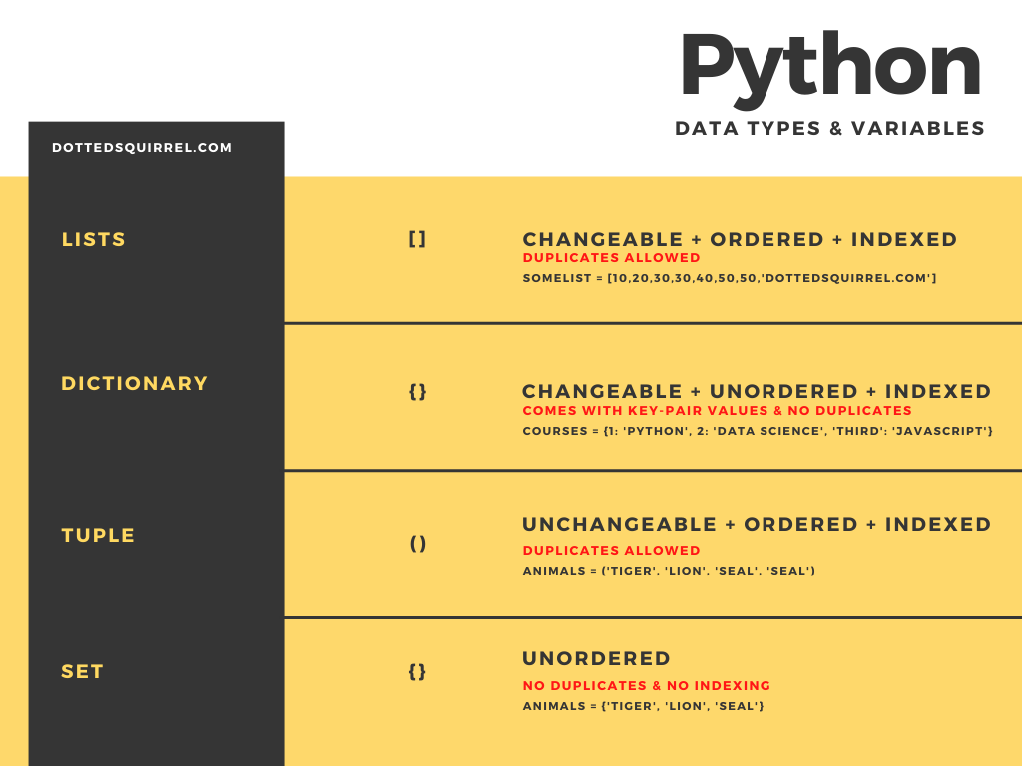
Data Types
Notes:
Image source: https://matcha.fyi/content/images/size/w1000/2021/06/2-1.png

